Slide 1

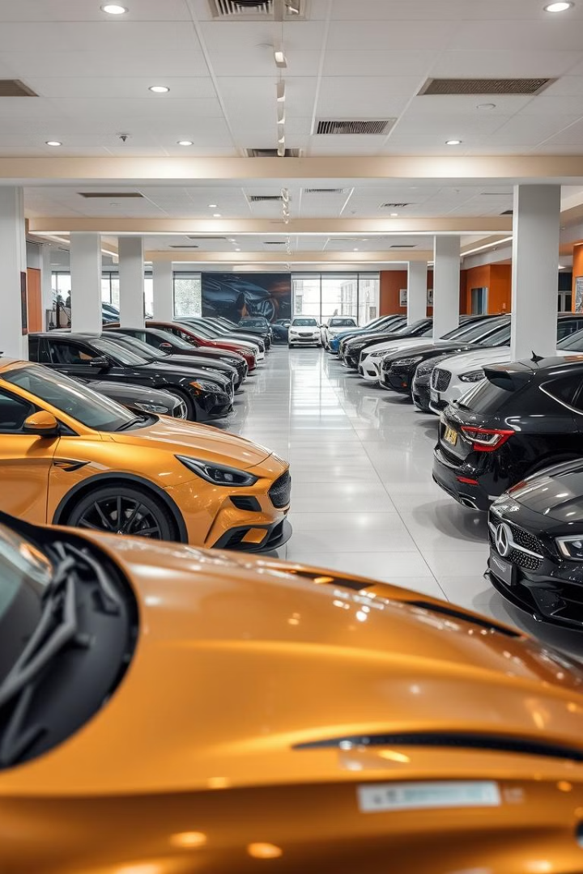

Used Cars Price Prediction
This presentation explores the used car market using a dataset from Car Dekho. We will analyze the data to understand key factors influencing car prices and build machine learning models to predict selling prices. The analysis includes data cleaning, exploratory data analysis (EDA), and model implementation.
The goal is to provide insights into the used car market and develop accurate price prediction models. We will cover data preprocessing, feature analysis, and the application of various regression algorithms to achieve this objective.
by ABHISHEK AHER

Slide 2
Data Overview and Cleaning
Initial Data Exploration
Data Cleaning
The dataset contains 4340 entries with 8 columns, including car name, year, selling price, kilometers driven, fuel type, seller type, transmission, and owner type. There are 1491 unique car names and 27 different manufacturing years.
The data cleaning process involved identifying and removing duplicate entries. A total of 763 duplicate rows were dropped to ensure data integrity. No null values were found in the dataset, simplifying the cleaning process.

Slide 3

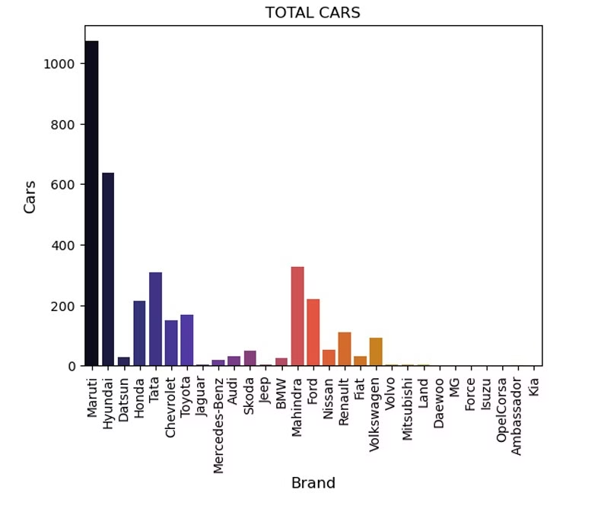
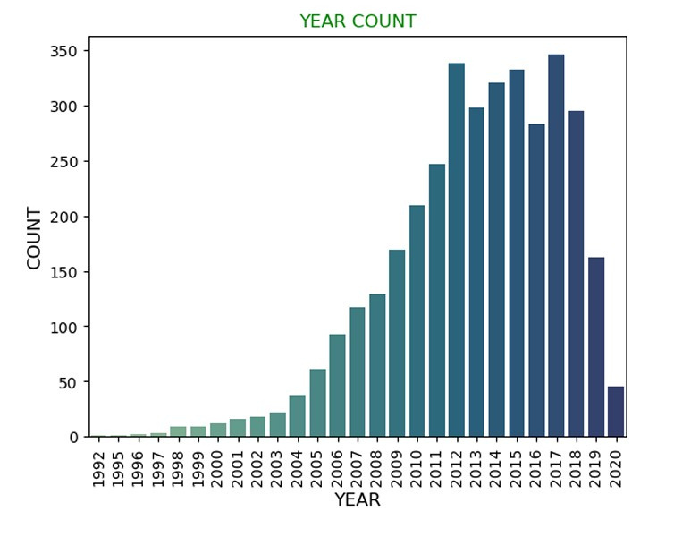
Exploratory Data Analysis (EDA)
1
Brand Analysis
2
Year Distribution
Maruti is the most frequently listed brand, followed by Hyundai and Mahindra. This indicates a strong presence of Maruti cars in the used car market.
The years 2017, 2012, 2015, and 2014 have the highest number of car listings, suggesting these years are popular in the used car market.
3
Fuel Type
Diesel and Petrol cars dominate the used car market, with CNG and LPG having significantly fewer listings. Electric cars have the least representation.

Slide 4
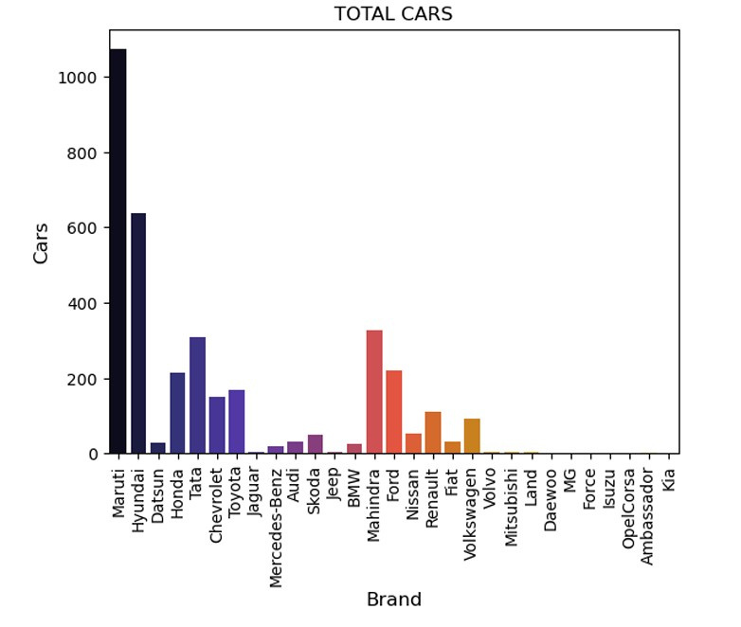
Brand Distribution
Maruti
Hyundai
Maruti cars account for a significant portion of the used car market, with 1072 listings.
Hyundai is the second most popular brand, with 637 listings in the dataset.
Mahindra
Mahindra cars have a notable presence, with 328 listings.

Slide 5
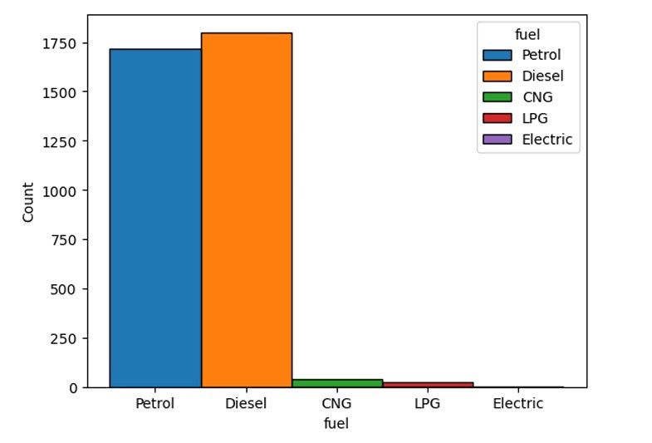



Fuel Type Analysis
Diesel
Petrol
CNG
Diesel cars are prevalent in the used car market, with 1800 listings.
Petrol cars are also widely available, with 1717 listings.
CNG cars have a smaller presence, with only 37 listings.

Slide 6



Seller Type Distribution
Individual
Dealer
Trustmark Dealer
Individual sellers dominate the used car market, with 2832 listings.
Dealers also have a significant presence, with 712 listings.
Trustmark Dealers have a minimal presence, with only 33 listings.

Slide 7
Machine Learning Model Performance
1
Linear Regression
Linear Regression achieved a score of 0.437, indicating moderate predictive power.
2
Random Forest
Random Forest Regressor performed better with a score of 0.624, showing improved accuracy.
3
XGBoost
XGBoost Regressor achieved the highest score of 0.665, demonstrating superior predictive performance.
4
Decision Tree
Decision Tree Regressor showed an accuracy of 1.0, but this is likely due to overfitting.

Slide 8
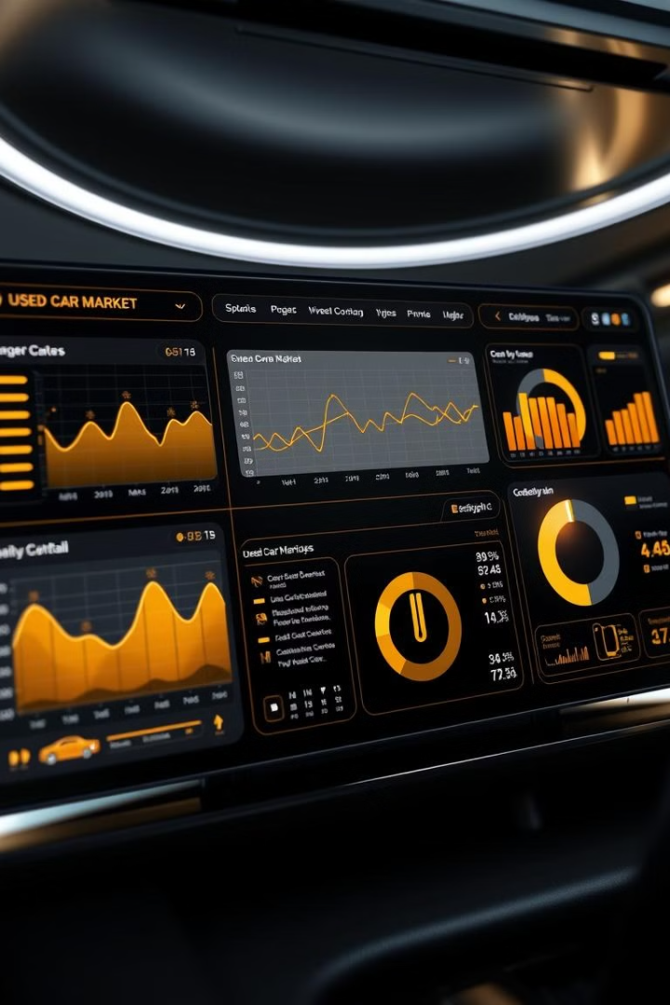
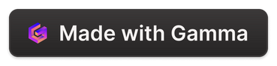
Key Takeaways and Next Steps
Insights
Model Performance
The used car market is dominated by Maruti, Hyundai, and Mahindra brands. Diesel and Petrol cars are the most common. Individual sellers are the primary source of used cars.
XGBoost Regressor provides the best predictive performance among the tested models. Decision Tree Regressor may be overfitting the data.
Next Steps
Further optimize the XGBoost model. Explore additional features and models to improve prediction accuracy. Deploy the model for practical use.

Slide 9
Thank You

